Slide 1
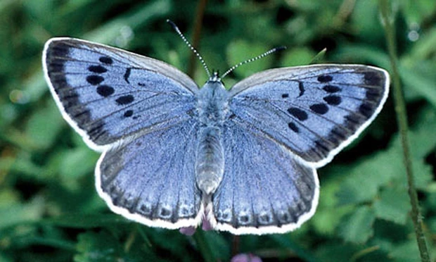
Systemic Trance Work: A Model for Sustainable Creativity
Stephen Gilligan Ph.D.

Slide 2
General Overview
We create our reality through brain/mind/body “representational maps” or “filters”
Performance systems (holons) are the prototype filter for self-operation.
These systems can be held in fixed (homeo-stat) or fluid (rheo-stat) consciousness.
Fixed maps result in disconnected, repetitive, increasingly problem-based realities.
Fluid maps allow an interconnected flow state of generative learning.
Systemic Trance is a method for transforming the stuck states of a problem-based system into the creative states of a generative system.

Slide 3
The Five Basic Premises

Slide 4
Premise 1:
We create
Our reality!

Slide 5
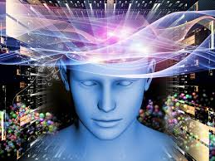
Examples of reality creation
Phantom limb pain
Emotional state dependency
“Placebo” pills
Kennedy: We will put a man on the moon!
China economic ”miracle"

Slide 6
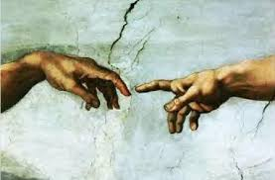
Premise 2: Creativity is a conversation
This conversation is between the creative unconscious (quantum) and the conscious (classical) worlds.
The creative unconscious is a holographic wave field containing “infinite possibilities”
The conscious mind “collapses the quantum wave” to create and navigate one reality.
Creativity moves between these two worlds; each completes the other.
Trance is an experiential exploration of the quantum world.

Slide 7
Three types of creativity conversations
The classical/quantum (“conscious/creative unconscious”) relationship.
The cognitive/somatic (“head/body”) connection.
Self/other conversations.

Slide 8
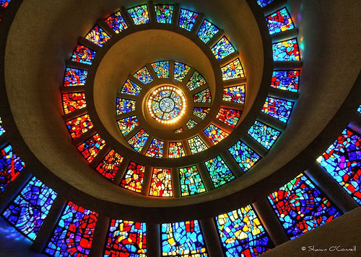
Premise 3: This conversation is filtered through representional maps
Filters translate quantum imagination into classical reality.
Three general types of filters: Somatic, Cognitive, and Field.
All we know is what our filters produce: Our maps are our reality.
We can generatively work with our filters.

Slide 9
Three types of filters for Systemic Trance work
Three types of mind: somatic, cognitive, and field
Different representational Maps (underlying state, present state, desired state, resources, obstacles, achievement maps)
The prototype filter: performance system map

Slide 10
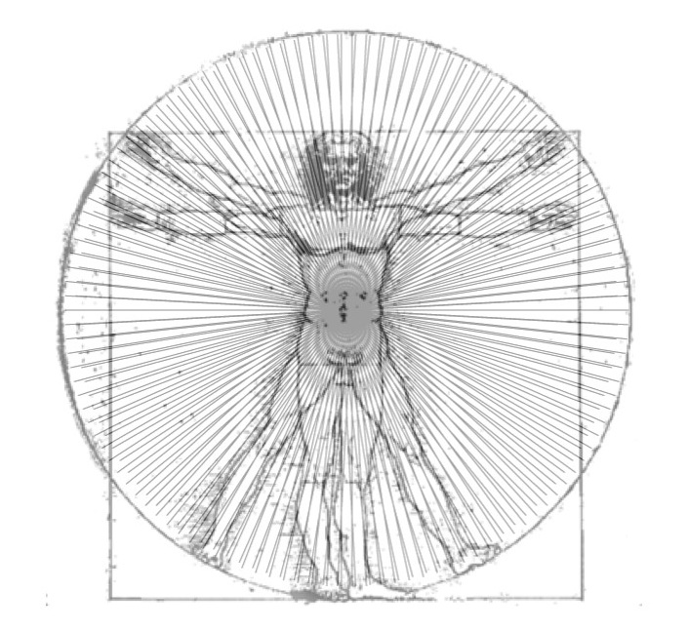
The three minds (filters) for creative consciousness
Three “minds” form the basis for the “creative unconscious”:
Cognitive – Brain/Intellect
Somatic – Body/Feeling
Field – Relationship/System

Slide 11
Peformance Systems (holons): The prototype representational map
Systems are relational fields of interbeing. Many systems exist: culture, family, vocation, performance self.
Generative Systems are holons: Each part is auto-poetically whole, but simultaneously a fragment of a greater whole.
Systems are holographic: Each part contains (and can self-generate) the whole.
Aesthetic intelligence: The music of the part/whole relationship expresses the quality of the system.

Slide 12
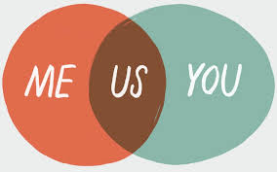
Examples of Holons: Part/whole generative collaboration
A generative individual or group
A musical band
Superb meal
Creative intimacy relationship (1 + 1 = 3)
A generative team or group

Slide 13
Holon: An interconnected system, where each part is also whole within itself

Slide 14
Examples of (Dominator) problem-based holons
War
Symptoms
Violence
Racism, militarism, poverty
Chronic illness
Destructive emotions (depression, anxiety, hostile anger)

Slide 15
Six elements of a performance holon
Desired state (goal/ intention /value/mission/etc.)
Present state
Achievement maps (“how”)
Resources
Obstacles
Underlying context (COACH vs. CRASH)

Slide 16
Context:
CRASH VS. COACH
present state
desired state
action plans
resources
obstacles

Slide 17
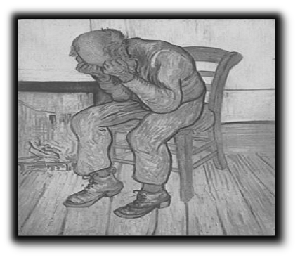
Premise 4: All experiential realities are held by human consciousness: “Mindless” or “Mindful”
1. When held mindlessly with neuromuscular lock--fight, flight, freeze, or fold--problems develop and repeat themselves.
2. When held mindfully with creative flow, solutions and new learnings are possible

Slide 18
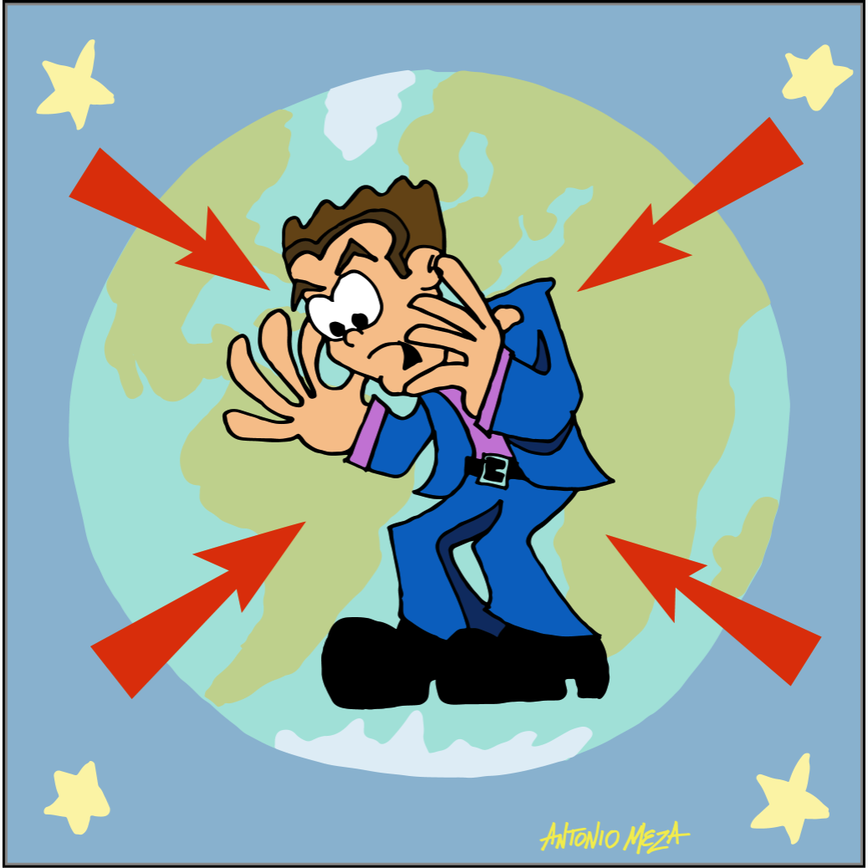
The CRASH State
Disconnected From the Whole
Contracted
Reactive
Analysis Paralysis
Separated
Hurting/Hating/Hitting
In a CRASH state you are contracted, reacting to the environment, analyzing, separated and feeling hurt or hate.
© 2014 Robert Dilts

Slide 19
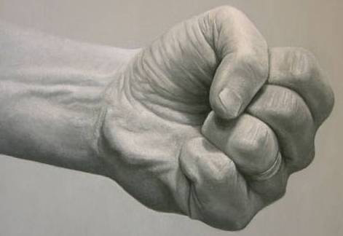
CRASH as “neuromuscular lock”
The Four F’s of Neuromuscular Lock
Fight Freeze
Flight Fold

Slide 20
Problem-based, limited self
Goal
Resource
Obstacle
Present
State
CRASH CONTEXT

Slide 21
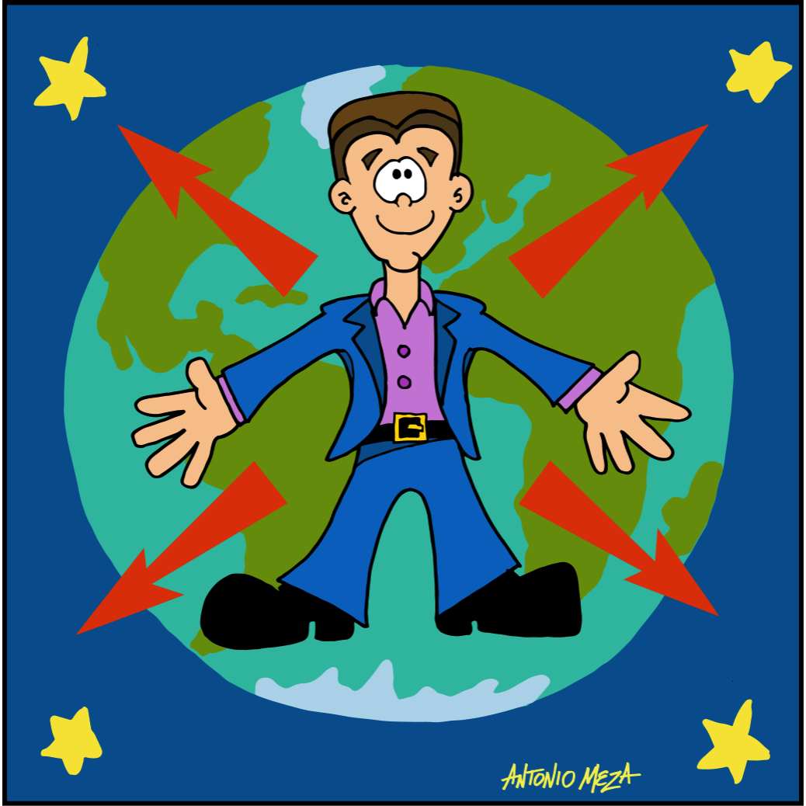
The COACH State
– Integrated Holon
• Center yourself, especially in your belly center
• Open your field of awareness
• Attend to what is going on within you and around you with mindfulness
• Connect to yourself and to the larger system(s) of which you are a part
• Hold whatever is happening from a state of resourcefulness and curiosity

Slide 22
Generative Holons: Each part is valued, interconnected, held in fluid forms.
center
Desired state
Obstacles
Present state
resources
Action Plans
COACH
field

Slide 23
Systemic differences that make the difference
Each part may be fixed or fluid: Homeo-stat vs. Rheo-stat
Each part may be negatively or positively valued.
Parts may be isolated or inter-connected
Aesthetic relationship may be balanced or imbalanced.
Field may be positive (COACH) or negative (CRASH)

Slide 24
The difference that makes a difference: A system can be in neuromuscular lock or creative flow
The same systemic pattern can be positive or negative, depending on the human presence.
Its quality depends on (1) its level of integrated differentiation and (2) its flow on horizontal and vertical dimensions, and (3) its capacity to fluidly adjust to changing conditions.
Thus, a system produces suffering or symptoms via (a) isolation of a part from the whole, and (b) non-musicality (no flow within system). Operations become merely mechanical, repeating their prior conditioning.
The same system can become generative when distinguished by creative flow and feedback, with a creative intelligence capable of creating something entirely new.
Generative trance within a COACH field is an excellent method for achieving this creative flow and transformation.

Slide 25
How a system creates problems and symptoms (CRASH holon)
Underlying field context: CRASH (anger/fear/disembodied/ depressed)
Some parts are not welcome or recognized.
Some parts are negatively valued (“bad”).
“Fundamentalism”: maps are rigid and feedback-unresponsive (surface content, forms, meanings)
Functional isolation (“dissociaton’) of parts.
Parts are in “zero sum” competition.
No systemic integrity: no center, no unified field, imbalanced and fragmented relationships

Slide 26
What blocks generative presence?
Neuromuscular lock
Chronic tension
DISCONNECTION OF PART FROM WHOLE
SINGLE POSITION/ MAP/ RESPONSE

Slide 27
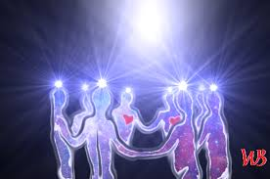
How a system creates solutions and positive growth (COACH holon)
Underlying “field”context: Limbic resonance, musicality, curiosity, feedback and feed-forward
Each part is welcomed
Each part is positively valued.
Each part’s maps are fluid and context sensitive: Infinite (form, content, meaning)
All parts are inter-connected and aesthetically balanced
Actions of part/whole are guided by aesethetic resonance.
“Mandala-like”: center, unified field, balanced pairs of opposites

Slide 28
Premise 5: Generative trance is a COACH field that allows systemic transformation
Trance is a creative field that can fluidly hold the multiple contradictory positions of a system
Trance allows fixed patterns to become fluid and changeable.
Generative trance allows simultaneous transformation of both parts and whole.

Slide 29
Generative Trance as mindful navigation of the creative world
Trance is putting primary attention into the quantum (dreamer) field, where everything is a fluid variable.
The creative unconscious has many possible forms, negative or positive.
Generative trance creates a positive, high-level field, “including and transcending” the values/patterns of a system, to allow transformation and creativity.
In generative trance, the conscious (realty-based) mind and the creative unconscious operate as creative partners.

Slide 30
Methods for Practicing Systemic Trance Work
The use of somatic models
Somatic modeling of COACH vs CRASH versions of six dimensions
The goal/obstacle/resource triad
The three positive connections
“Good self/bad self”
The use of somatic centering to integrate conflicting parts
The use of somatic modeling to integrate conflicting parts

Slide 31
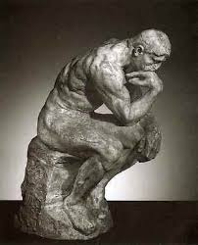
Systemic “trance-formation” through somatic modeling
Somatic model: A posture and simple movement to represent a pattern (goal, resource, relationship exchange, problem)
Somatic models illuminate the deep structure pattern the creative unconscious is bringing into play.
Via a “trance dance” in generative trance, the positive value and intention can be realized and expressed.

Slide 32
Applications of somatic modeling and somatic centering :
COACH state
CRASH state
Intention/goal
Commitment to intention/goal
Achievement of intention/goal
Obstacles
Resources

Slide 33
Somatic modeling of CRASH and COACH representations of the 6 GC steps
One step in creative performance is _____/
A CRASH (negative) representation of that might be ________
A COACH (generative) representation of that might be ________
Use this form to show somatic models for each of the 6 steps:
1. Self-connection
2. Commiting to intention/goal
3. Developing a creative performance state
4. Taking action steps
5. Engaging/transforming obstacles
6. Commitment to daily practices

Slide 34
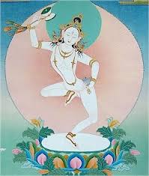
The “goal/obstacle/resource” triad
Preparation Step: COACH, goal, layout timeline
Position1: A first step I can take is (somatic model)....an obstacle that may arise is (somatic model)....a resource to help me is (somatic model)..somatic model integration of goal/obstacle/resource.
Repeat for 2-3 more steps, moving through timeline.
(optional) move backwards in steps, using same process
Sense timeline, make commitment, sensing need for goal/ recognizing obstacles/adding resources.

Slide 35
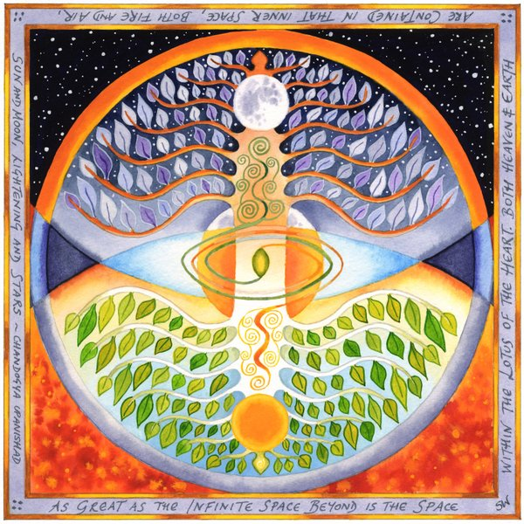
Basic prototype methods for Transforming Obstacles
Good self/bad self
Integrating opposites through somatic centering.
Integrating opposites through somatic modeling.

Slide 36
Exercise: “Good self/Bad self”
Partners center, open, limbically attune
Person A: What I want you to see is that I am “X”…and what I don’t want you to see is that I am also “Y”
Person B: I see that you are “X”…and I see that you are “Y”…I see both….and I see much, much more!
Switch, then repeat (w/ new content) 3-4 times.

Slide 37
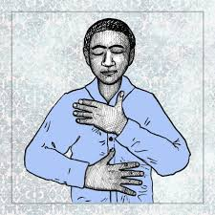
Trance-formation of conflicting parts using somatic centering in generative trance
Develop COACH, generative state.
Identify conflict: I want X, but Y stops me
Attune to X: Sense center, sponsor, self-scale
Attune to Y: Sense center, sponsor, self-scale
Optimize X and Y intensity levels, then move into generative trance to develop energy flow between them
Elaborate and deepen in generative trance.
Future orient: See positive changes, note learnings, vows, gratitude.

Slide 38
Tranformational “Trance Dance” : Somatic modeling of goal/ problem
ID goal/problem: I want X, but Y interferes
Develop somatic models of X and Y
Open COACH field (generative presence)
Develop generative state (e.g, 3 pos. connections),
Explore generative “trance dance” of X/Y with: positive intention (What is my unconscious trying to create?), limbic resonance, slow repetition, curiosity, relational mantras,
Sensing integral X/Y relationship, ask creative unconscious to develop new ways to express X/Y, allowing modified somatic models.
Integration, sensing “both/and” relationships of X/Y
Future orient, vows, gratitude, reorient.

Slide 39
When/where the methods isn’t working
Identify where the COACH state is lost.
Assess which COACH dimensions are disconnected. (use 1-10 scaling)
Select which one(s) to “upgrade.”
Feedback-sensitive connections until generative state is realized, and step is successfully achieved.

Slide 40
The three positive connections: A prototype platform for generative systems
Many possible “systems” can be distinguished—for example, culture, family, social contexts, cognitive schema, self-identity.
There are over 300 psychotherapy “systems” or theoretical approaches.
In Generative Psychotherapy, one way to model a system is through the 3 main systemic filters: Cognitive, Somatic, and Field.
The prototype form for a generative system is the triad of Three Positive Connections: (1) Positive intention/goal, (2) Somatic presence, and (3) Resources. This can be used as the basic platform for creating new desirable responses.
The protoype can also be used to transform symptom-based systems, following an Ericksonian pattern: (1) Identify problem system, (2) Move it into a generative (trance) field, (3) translate it into a resource system.

Slide 41
The three positive connections: The platform for creative system
Positive intention/goal (succinct: 5 words or less; resonant) What do you most want to create in your life?
Mindbody center (experiences of well-being) Where do you most deeply feel the connection in your body?
Positive resources (people, places, things, skills, ancestors, etc.) What connections would best help you achieve your goal

Slide 42
Transforming a “symptom system” to a generative system w/ the 3 connections
Identify “problem system”: goal, somatic patterns, others involved.
Open the COACH field of a generative trance, develop 3 positive connections in regards to transforming problem system.
Attune to intention: Identify present maps, use feedback (finger signals, self-rating, resonance) to identify better maps.
Repeat process for somatic state.
Repeat for contextual field presences (replace negative sponsors with positive sponsors)
Slowly move through three new maps, allowing “trance-formation” of new system.
Future orient: Notice important changes,

Slide 43
Conditions for deep identity change
COACH
Flow in process
Rheo-stat in each representation
Positive valuing
Balanced “tea ceremony”

Slide 44
Gen Coaching Pre-session 6 steps
28
IN Generative Coaching, we find there are six important areas for sustainable creativity: (1) getting into a positive (COACH) state; (2) connecting to positive goals; (3) developing and maintaining creative performance states; (4) outlining timeline action plans; (5) overcoming obstacles; and (6) establishing daily practices. Please write down your best answers to these six elements, to help both you and me in the work.
Your ways of positive self-connection. Please list several ways you find positive self-connection with yourself (e.g., walking in nature, music, pets, breathing/meditation, etc.)
Positive goals/intention. What I would most like to create/experience/achieve in my life is ___________. Give at least several positive answers, that is, experiences you would want to have.
Creative state. Identify resources you have (people, places, historical or spiritual beings, ancestors, teachers) that allow you to access a positive state. Also identify any ways you cultivate a positive performance state.
Plans/timelines. What changes do you think you need to make to achieve your goal? What actions do you need to take? What connections need to be established?
Obstacles. What emotional states do you think block you from achieving your goals? Which relationships do you think you need to change/repair?
Daily practices/homework: Do you have any daily practices for self-attunement? If so, please list, including how much daily time you give for them. Also, ideas for adding daily practices?

Slide 45
End of GC session: Feedback form
28
Any positives outcomes of our work depends on much honest feedback. Regarding this session, please rate the following, using a 1 to 10 scale (1-3 = not at all, or not much; 4-7 = somewhat but not fully; and 8-10 = very much, or completely).
I felt heard, understood, and respected.
WE focused on what I really wanted/needed to focus on.
The approach is a good fit for me.
There was something missing in the session for me.
I feel more confident about achieving my stated goals
I feel more open and creative regarding my negative states.
My overall rating of the session.
Other….Please offer any additional feedback.

Slide 46
Generative Change Post-Session Form
28
Now that we’ve done some work, let’s revisit your connection to what we call the 6 elements of Generative Change. Please reflect upon and write down your present relationship to the 6 elements.
Your ways of positive self-connection. Note any changes in: ease, frequency, stability, or way of developing your positive self-states.
Positive goals/intention. Have your goals/intention changed? On a scale of 1-10 scale, how much have you achieved your goals? What’s more to do?
Creative state. In terms of developing a positive performance state where you can feel/think/and act creatively, how much are you able to do that now? What are your best ways? What do you need to work on here?
Plans/timelines. How much of clear timeline have you been able to develop? What small steps are still needed? Are you keeping track of specific goals and daily achievement?
Obstacles. How much of a shift have you experienced regarding the negative states that have previously overwhelmed you? Biggest challenges in terms of facing, transforming, and creatively engaging with the negative obstacles?
Daily practices/homework: What daily practices do you have, how frequently are you practicing them, and what is your daily “average level” of well-being?

Slide 47
Generative Change Audio Series
An 4 part audio series exploring the tools, principles & practices of Generative Change
Part 1: The Six Steps of Generative Change
6 Steps of Generative Change; Generative Trance; 6 Steps of Generative Change; Generative Coaching
Part 2: Developing the Coach State
Heaven/ Earth (Vertical Axis); Positive Memory Revivification; 3 Mindfulness Drops; Aiki Principles, Sensory Awareness (Mrs Erickson Process); Energy Ball; 3 Point Attention; 5 Generative self suggestions.
Part 3: Mastering Core Practices
Somatic Modelling; Somatic Centering ; 4 Connections of a Generative Relationship; Self Rating Scales, Goals in 3 Modalities; 3 Positive Connections; 4 Relational Mantras; Goal-Obstacle-Resource Triad; Archetypal Energies; Tetra Lemma; Keeping the Client Connected]; When the Coach Feels Stuck; Further Practices.
Part 4: Applications of Generative Change Work
Moving towards a positive feature using your vulnerabilities; Light Trance Identification with a Positive Model, Transforming Pain; Sleeping Soundly; Community of Resources; Changing Negative Habits; Healing Intimacy Wounds; Transgenerational Lineages
To purchase visit www.stephengilligan.com

Slide 48
Thank You..... And May the Force be with you!
Stephen Gilligan, Ph.D.
www.StephenGilligan.com

