Slide 1
The Primacy of Nonverbal Communication in Creative Trance Work
Stephen Gilligan, Ph.D.

Slide 2
General overview
Experience is constructed via an interaction of cognitive and somatic intelligence (mindbody connection)
A negative relationship between them can create symptoms.
Shifting to a positive relationship can transform symptoms into resources.
Attuned nonverbal communication is the underlying base for this shift.

Slide 3
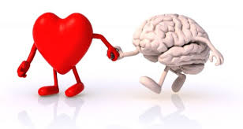
The dual mind hypothesis: Early versions
Freud: Primary/secondary process
Hobbs: Unordered/ directed
Head: Nonverbal/ symbolic
Bateson, Pribram: Analogical/digital
McGilchrist: Holistic/ analytical (whole/parts)

Slide 4
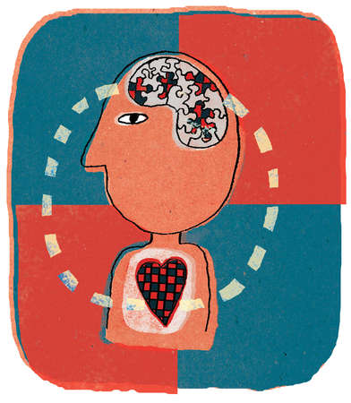
Recent models in cognitive science
Hot/cool thinking (Abelson, Mischel)
Fast/slow thinking (Kahneman)
“Low road/ High road” (LeDoux)

Slide 5
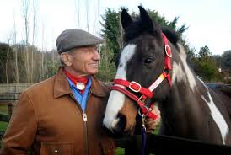
A good working metaphor for trance work
William James (and later Paul MacLean):
The unconscious is a horse
(mammal mind),
The conscious mind is the rider
(human presence)

Slide 6
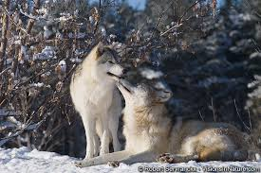
The values of the mammal mind
Embodied presence
Emotional intelligence
Fast, unconscious assessment
Instinctual, archetypal
Vast storehouse of resources
Subtle differentiation
Relational interbeing

Slide 7
Humanizing the mammal (unconscious) mind
What comes) out of the unconscious is not fully human; its value and human form comes from human presence (conscious mind)
When the conscious mind ignores or negatively treats the unconscious (CRASH), problems and symptoms develop
When these problems and symptoms are brought into positive human presence (COACH), transformation can occur
The positive human presence requires embodied and subtle awareness (relational mindfulness)

Slide 8
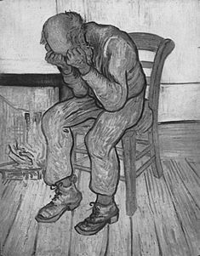
The CRASH State
The Underlying Context of Symptoms
Contracted
Reactive
Analysis Paralysis
Separated
Hurting/Hating/Hitting

Slide 9
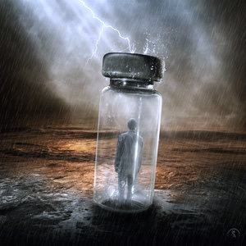
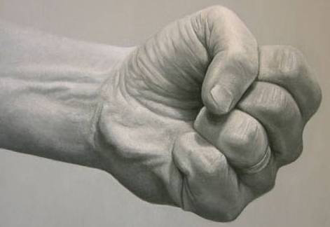
CRASH as “neuromuscular lock”
The Four F’s of Neuromuscular Lock
Fight Freeze
Flight Fold

Slide 10
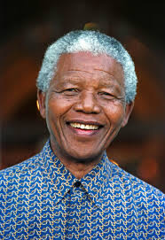
The COACH State
The Basis for Creative Change
Centered
Open
Aware
Connected
Holding

Slide 11
The difference that makes a difference: A system can be in neuromuscular lock or creative flow
The same systemic pattern can be positive or negative, depending on the human presence.
Its quality depends on (1) its level of integrated differentiation and (2) its flow on horizontal and vertical dimensions, and (3) its capacity to fluidly adjust to changing conditions.
Thus, a system produces suffering or symptoms via (a) isolation of a part from the whole, and (b) non-musicality (no flow within system). Operations become merely mechanical, repeating their prior conditioning.
The same system can become generative when distinguished by creative flow and feedback, with a creative intelligence capable of creating something entirely new.
Generative trance within a COACH field is an excellent method for achieving this creative flow and transformation.

Slide 12
When nonverbal intelligence is disconnected
Neuromuscular lock: The freezing of brain/mind/body experience into into isolated, fixed maps.
The rheo-stat needed for fluid change is lost to homeo-stat representations.
The social connections needed for happiness and success are not felt.
Relaxation, pleasure, playfulness, openness, curiosity are inhibited.

Slide 13
When nonverbal intelligence is active and integrated
Presence and connection are restored
Relaxation allows releasing tension, fixed understandings, anxiety, and chronic negative states
Nonverbal musicality allows reawakening of creative engagement.
Nonverbal resonance reconnects ego self to both individual cognitive/somatic connections and interpersonal resonance.
All these support creative change and transformation.

Slide 14
Core experiences as problems or solutions: Two level theory of reality construction
At the primary (quantum) level of the creative unconscious, patterns are archetypal deep structures that have infinite possible forms/meanings/values.
At the secondary (classical) level of the conscious world, these deep structures “collapse” into a particular “surface structure” with specific forms, values, and meanings.
A pattern become negative or positive, depending on the human presence connecting with it. (COACH vs. CRASH)
Thus, a negative experience is an archetypal resource that has been held with negative human presence.
To transform a negative experience into a positive resource, bring skillful, positive human presence (COACH/ generative trance) to it.

Slide 15
Problem or Resource: Depends on Human Connection/Context
Archetypal (core) pattern + CRASH = problem (“negative trance”)
Archetypal (core) pattern + COACH = Resource (“generative trance”)
Problem + COACH = Resource

Slide 16
Nonverbal methods for Generative Trance Work
Limbic attunement
Relational focusing
Somatic centering to transform negative experiences
Somatic modeling

Slide 17
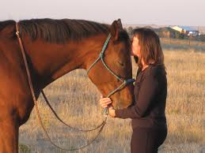
Limbic attunement and resonance: The underlying base for Generative Trance
Client’s goal or intention is expressed as a positive trance suggestion: You really can experience/do X.
Therapist offers suggestion in 3 ways:
Authoritarian and too intense
Passive and “held back”
With limbic resonance
Discussion, then switch

Slide 18
Relational focusing
Preparation: Open COACH field.
Client talks, Therapist listens to “client music” (not words)
Therapist finds and touches own resonant center
Maintaining own center, Therapist becomes curious about Client center, asks client to pause and sense it.
Client centers, begins to speak again, only in way that sustains felt sense of center.
Both Therapist and Client attune to center, using it to guide process.
Reorient and discuss.

Slide 19
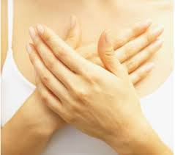
“Trance-formation” of negative experiences via Somatic Centering
Preparation: COACH field, 3 pos. connections.
Identify goal and interfering “problem”.
Locate somatic center and sponsor:
Relational resonance: Touch w/ mind/hand
Personal pronoun (“he” or “she”)
Related age (“Let a number come….”)
Four relational mantras (That’s interesting, I’m sure that makes sense, Something is healing, Welcome)
Move into generative trance, allow new meanings, connections, images, expressions to develop
Future orient: See positive future, vows, gratitude.

Slide 20
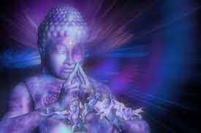
Four Skill Sets for Transforming Negative Experiences
Developing a Generative State
Humanizing the negative experience
Relational “mantras”
Weaving positive resources

Slide 21
Skill Set # 1: Developing a Generative State
Positive intention
Centering
Positive resources
Limbic attunement

Slide 22
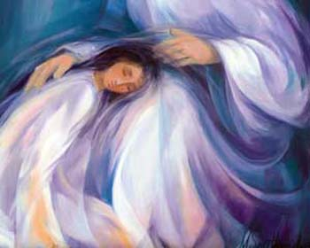
Skill Set # 2: Humanizing an experience
Give Somatic Place
Limbically attune and resonate
Identity relevant age(s)
Use personal pronouns (“he” or “she”)

Slide 23
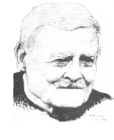
Skill Set # 3: Relational “mantras”
That’s interesting....
I’m sure that makes sense....
Something is trying to wake up (or heal)
Welcome!

Slide 24
Skill Set # 4: Integrating Positive Resources
An experience becomes/remains “negative” via isolation (functional dissociation) from larger human contexts.
The simultaneous presence of positive resources can bring a negative experience back into creative flow, thereby allowing creative transformation.
A resource is any experiential pattern that “sources” a person’s creative consciousness.
Thus, to transform negative experiences into positive resources, bring them into a generative field with multiple resources.

Slide 25
“Trance-forming” negative experiences through somatic modeling
Somatic model: A posture and simple movement to represent a pattern (goal, resource, relationship exchange, problem)
Somatic models illuminate the deep structure pattern the creative unconscious is bringing into play.
Via a “trance dance” in generative trance, the positive value and intention can be realized and expressed.

Slide 26
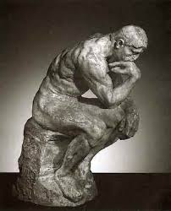
Generative Trance-Formation via Somatic Modeling
Open COACH field, develop generative state.
ID goal: I want to transform X (or achieve Y)
Develop somatic model
Develop generative trance by repetitively moving through somatic model with generative resources: positive intention (What is my unconscious trying to create?), limbic resonance, slow repetition, curiosity, relational mantras, etc.
As positive intention is sensed, ask creative unconscious to unfold new (more ecological) ways to honor it.
Future orient: See positive future, note learnings, vows/commitments, gratitude.

Slide 27
Thank You..... And May the Force be with you!
Stephen Gilligan, Ph.D.
www.StephenGilligan.com

